Slide 1


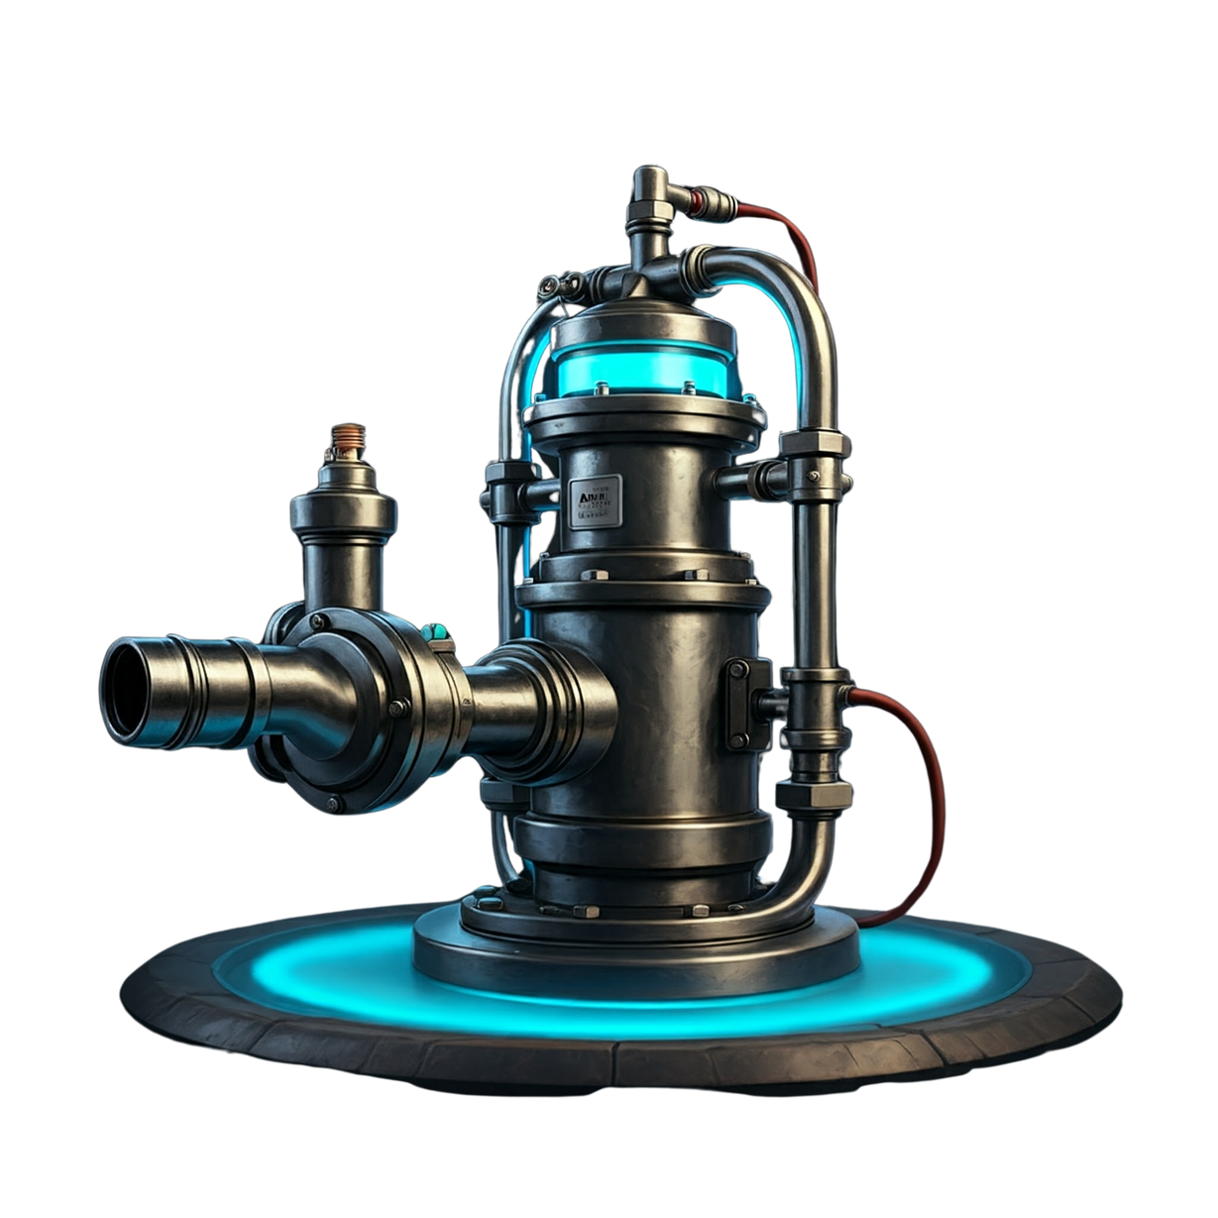


DEBUTANTS X
AI SMART
PUMP
CODECORTEX

Slide 2
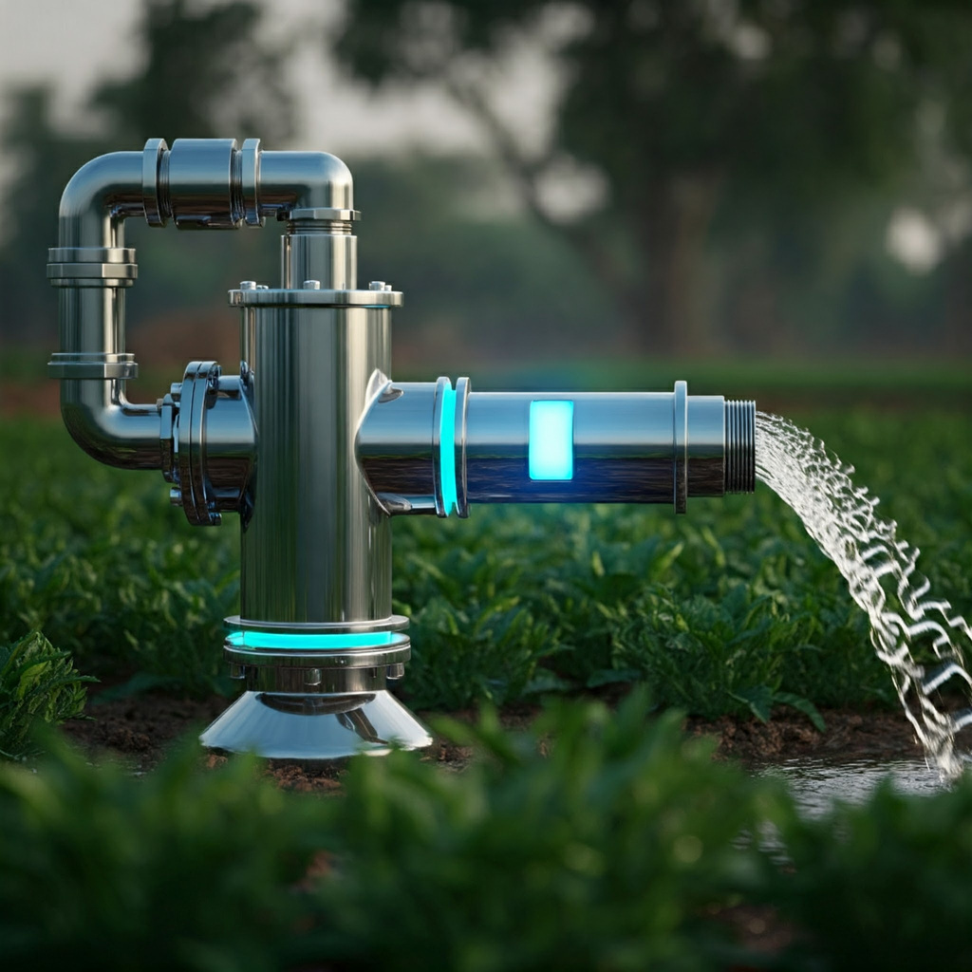

Introduction
Efficient water management is a crucial challenge in agriculture, especially in India. AI-driven irrigation offers a solution by automating water usage based on real-time sensor data like soil moisture and weather conditions.
Our project introduces an AI-Driven Smart Pump that automatically determines when to turn the pump ON or OFF based on environmental data. This system ensures optimal irrigation, reducing water waste and improving crop yield, while also saving time and labor for farmers.
By using AI, we aim to solve the problem of water scarcity and make irrigation smarter and more efficient.

Slide 3

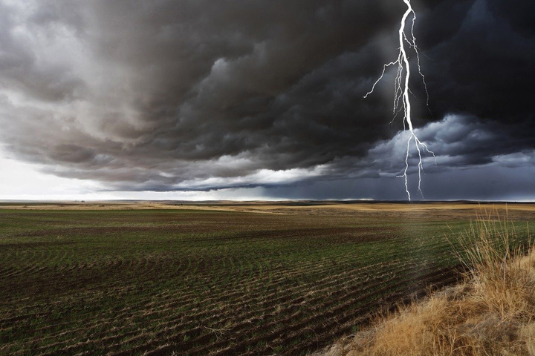
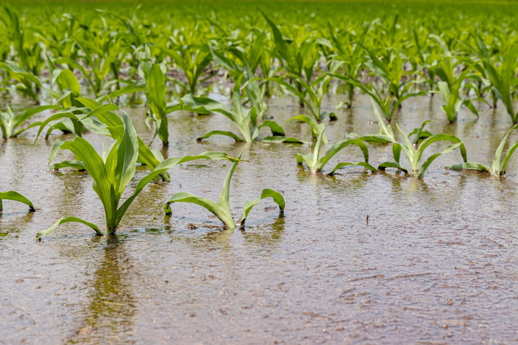
Problem Statement
Water Waste: Over-irrigation wastes water; the AI pump optimizes water usage based on real-time data.
Over-/Under-Irrigation: Incorrect watering damages crops. The smart pump balances moisture levels, protecting plants.
Energy Inefficiency: Pumps only run when necessary, reducing energy use.
Lack of Adaptability: The system adjusts to crop type and growth stages, improving productivity.
Climate Variability: AI accounts for real-time weather, ensuring irrigation adapts to climate changes.

Slide 4

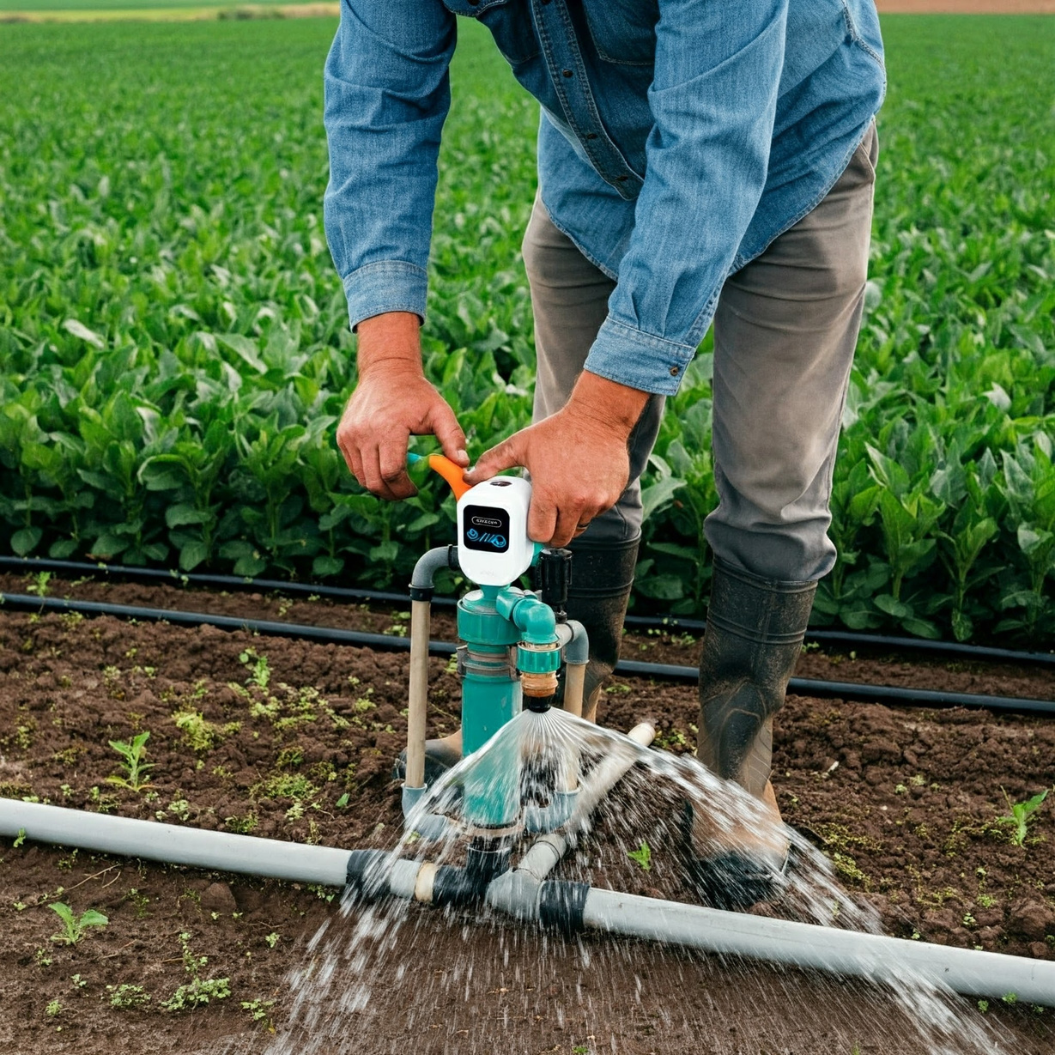

Market Opportunity
The current agriculture market has enough potential to adapt this new age technology and create a difference in the agriculture sector
1
Target Market Segments
2
Market Overview
3
Market Trends
Farmers & Agricultural Producers: Small to large-scale farmers seeking efficient irrigation solutions.
Commercial Agriculture: Greenhouses, nurseries, and landscaping businesses.
Smart Farming Solutions: Early adopters of IoT and AI technology in agriculture.
Global Agricultural Pump Market Size: $5.2 billion in 2024, projected to reach $9 billion by 2031 (CAGR of 7.2%).
Irrigation Systems: Increasing need for efficient water management due to water scarcity and climate change.
Sustainable Practices: Growing focus on water conservation and sustainable farming practices.
Automation and IoT Integration: Rising demand for automated irrigation systems to optimize water usage.
Government Initiatives: Support for smart farming through subsidies and grants.

Slide 5
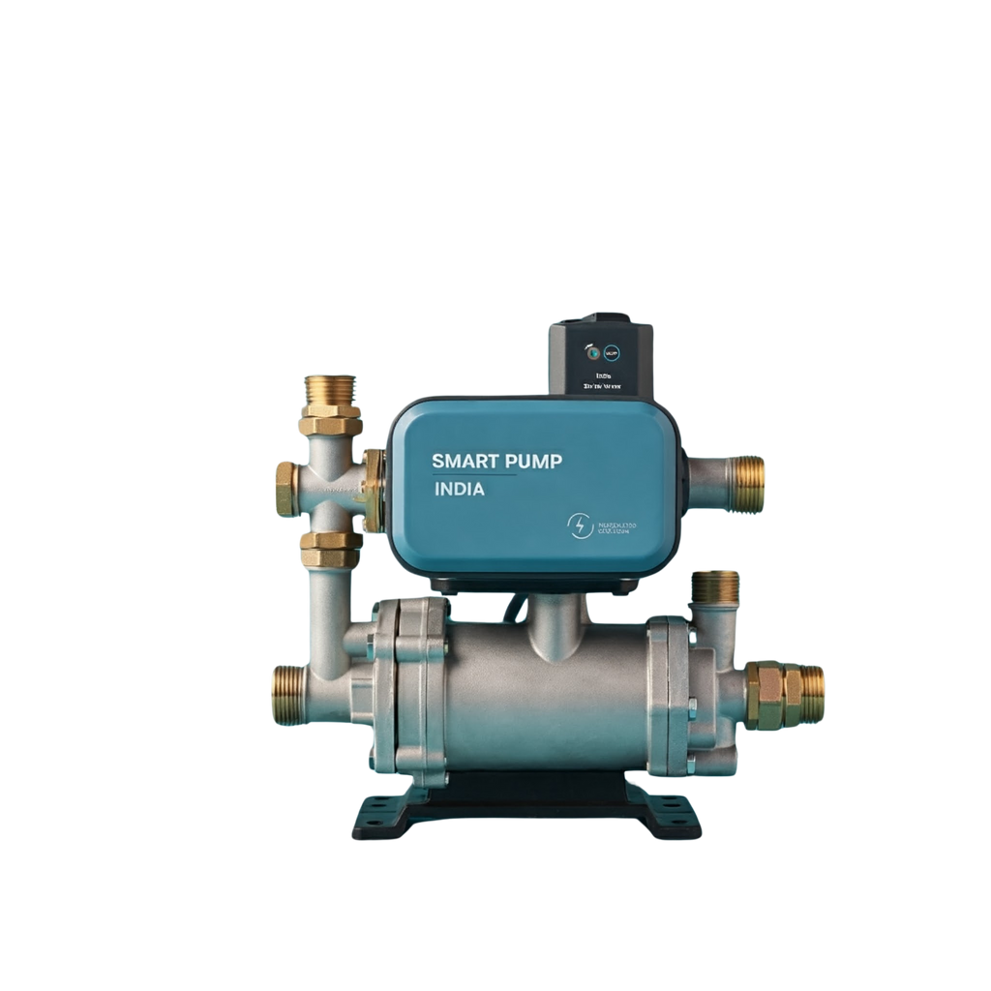
Cost Structure for Smart Pump System
1
2
3
₹30,000-₹60,000
Initial Setup Costs
Software Development Costs
Marketing and Sales Costs
Total Cost
Smart Pump Unit: ₹20,000 - ₹30,000
Sensors (Soil Moisture, Temperature, Humidity, Rainfall): ₹5,000 - ₹15,000 (for all sensors)
Control Unit (Microcontroller, etc.): ₹2,000 - ₹5,000
Installation Costs: ₹5,000 - ₹10,000
App Development (UI/UX, Backend): ₹10,000 - ₹25,000
Maintenance and Updates (Annual): ₹5,000 - ₹10,000
Promotional Campaigns: ₹5,000 - ₹15,000
Sales Channels and Distribution: ₹3,000 - ₹10,000

Slide 6


Proposed Solution
REAL-TIME DATA UTILIZATION
ADAPTABILITY
The system can tailor water delivery based on specific crops and their growth stages, ensuring that each plant receives the appropriate amount of water.
The smart pump uses data from soil moisture, weather conditions, and other environmental factors to make informed decisions about irrigation.
AUTOMATED DECISION-MAKING
USER-FRIENDLY INTERFACE
Utilizing AI algorithms, the system autonomously determines when to turn the pump ON or OFF, ensuring optimal watering based on actual needs.
A dashboard allows farmers to monitor real-time sensor data and receive alerts, making it easy to control irrigation remotely.

Slide 7
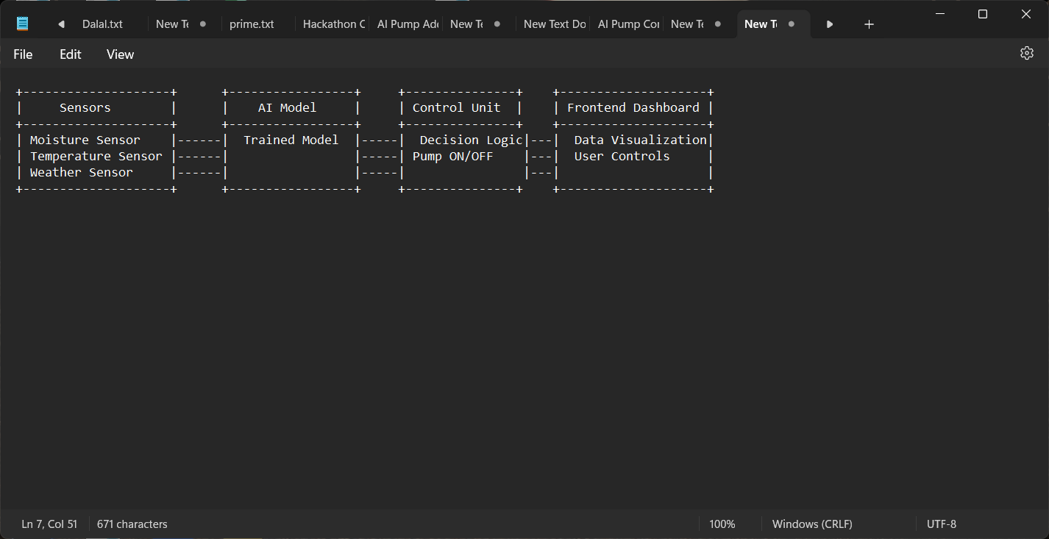
Architecture Overview
The AI-Driven Smart Pump system comprises several key components that work together to optimize irrigation
Sensors
Soil Moisture Sensors: Measure the moisture content in the soil.
Weather Sensors: Gather data on temperature, humidity, and precipitation.
Water Quality Sensors: Monitor pH and turbidity to ensure suitable irrigation water.
Data Processing Unit
Collects data from sensors and processes it to determine irrigation needs.
Uses machine learning algorithms to analyze historical and real-time data.
AI Model
Predicts whether the pump should be ON or OFF based on processed data.
Continuously learns from new data to improve accuracy and efficiency.
Automated Valve Control
Controls the water flow based on the AI's decisions, ensuring precise irrigation.
Frontend Dashboard
User interface for real-time monitoring and control of the irrigation system.
Displays sensor readings, pump status, and provides alerts.

Slide 8

AI Model Details
Data Input:
Soil moisture levels
Weather conditions (temperature, humidity, rainfall)
Water quality parameters
Machine Learning Algorithms:
Utilizes machine learning techniques to analyze historical data and identify patterns.
Trained on datasets that include past irrigation outcomes to learn optimal watering practices.
Decision-Making Process:
The AI model processes the input data to predict whether the pump should be ON or OFF based on the current conditions.
It considers factors such as soil moisture thresholds, crop water requirements, and recent weather patterns.
Continuous Learning:
The model continuously updates itself with new data, improving accuracy over time.
It can adapt to changing environmental conditions and different crop types, ensuring effective irrigation.
Output:
Provides real-time recommendations for pump operation, allowing for timely irrigation adjustments that maximize efficiency and minimize waste.

Slide 9
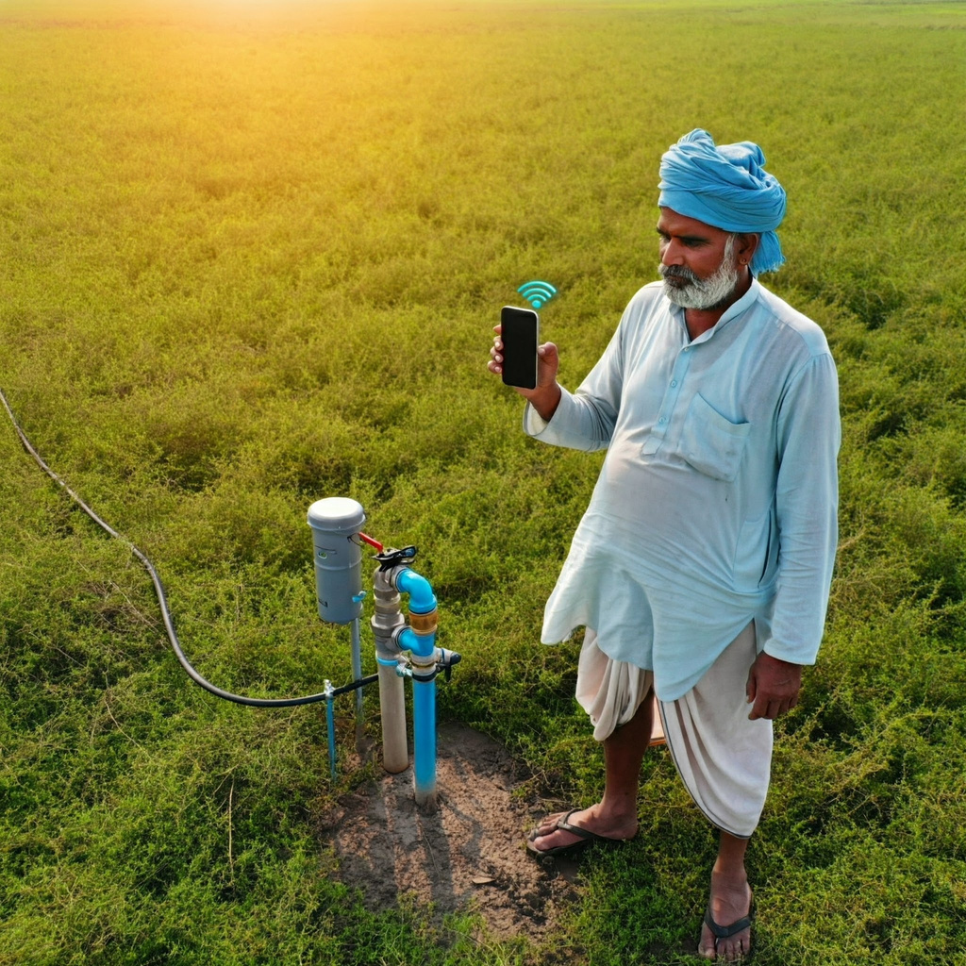
Frontend for End-User
Real-Time Monitoring:
Displays live data from all connected sensors, including soil moisture, temperature, and weather conditions.
Visual representations (graphs/charts) help users quickly assess the irrigation status.
Pump Status Updates:
Clearly indicates whether the pump is currently ON or OFF based on AI predictions.
Provides alerts and notifications for any system anomalies or required actions.
Historical Data Visualization:
Allows users to review past irrigation data, helping them understand trends and make informed decisions for future irrigation practices.
Control Options:
Users can manually override the AI decisions if needed, providing flexibility in unique situations.
Automated scheduling options to set specific irrigation times based on user preferences.
User-Friendly Interface:
Easy navigation ensures that farmers, regardless of tech-savviness, can interact with the system confidently.
Accessible on both smartphones and computers for convenience.

Slide 10

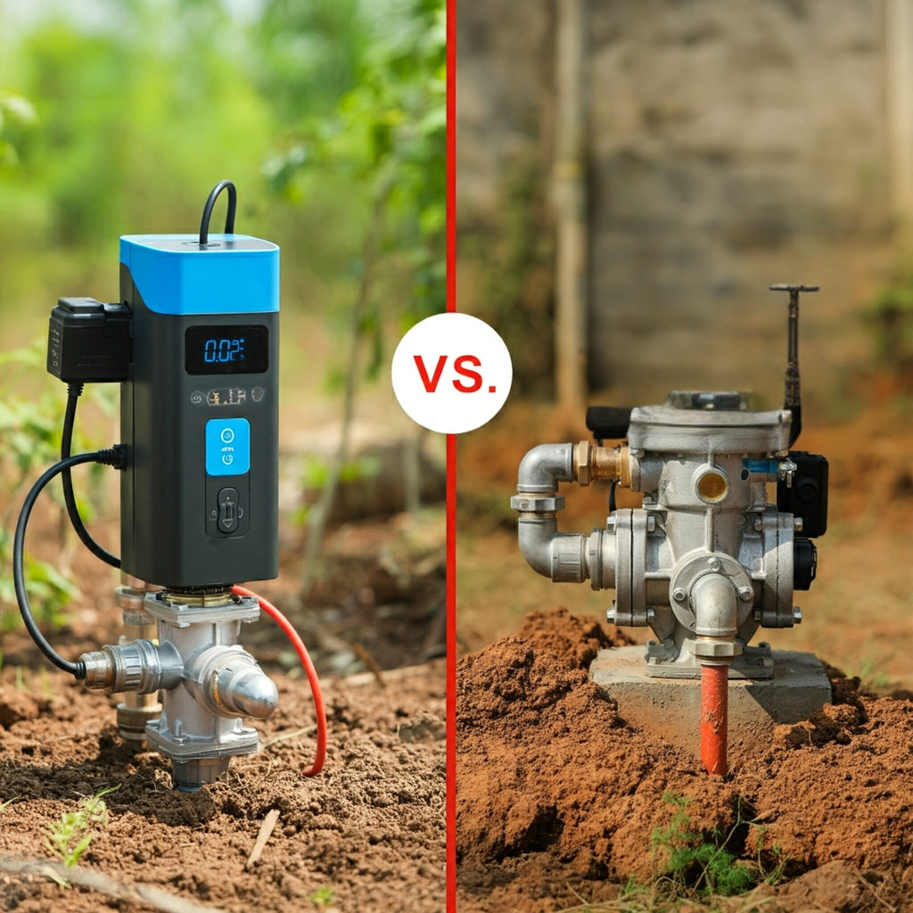
DEBUTANTS X
Classical Pump
Lower (~₹15,000 - ₹40,000)
Manually controlled, less efficient
Higher (~₹30,000 - ₹60,000)
Higher Energy Consumption
Visualize the people who
will turn to your product
or service solutions.
Optimized using AI, more efficient
No Data Insights
Lower Energy Consumption
No Remote Control
Provides analytics, insights for optimization
Remote Controlled
Classical Pumps vs. AI-Driven Smart Pumps
AI-Smart Pump

Slide 11
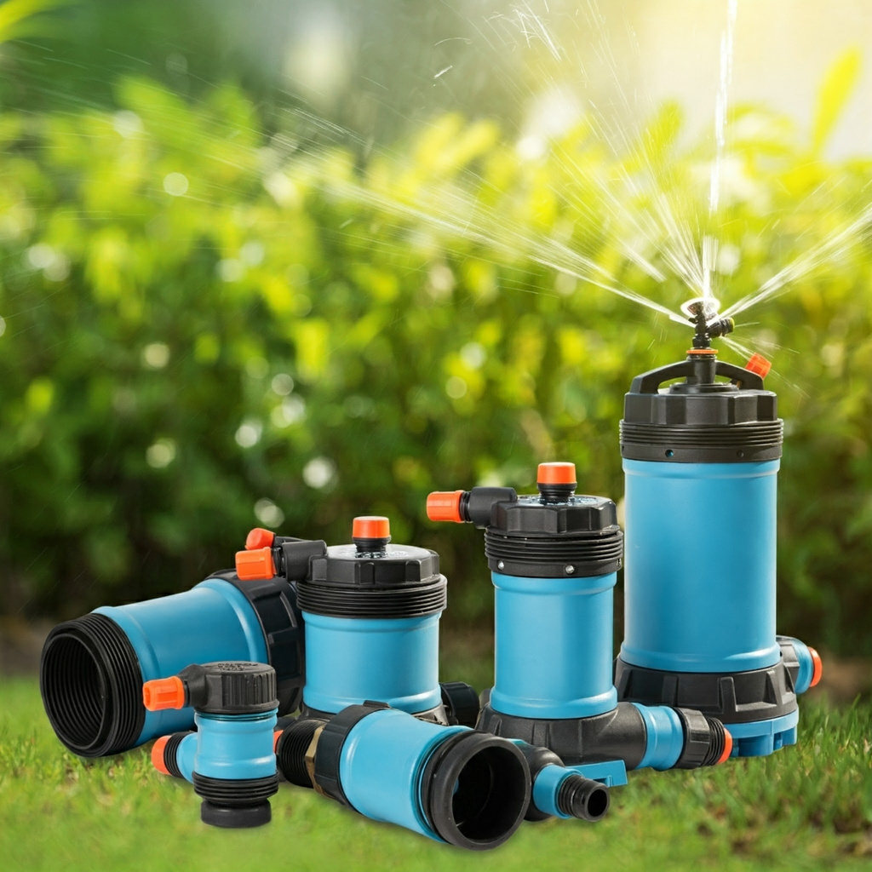
Use Cases
The AI-Driven Smart Pump offers versatile applications in modern agriculture, enhancing irrigation practices across various systems. Here are some key use cases:
Drip Irrigation Systems:
The smart pump can be integrated with drip irrigation setups, delivering precise amounts of water directly to the plant roots.
This minimizes water wastage and maximizes efficiency, especially in arid regions where water conservation is critical.
Fertigation Systems:
The AI pump can work with fertigation setups, where water and fertilizers are delivered simultaneously.
This ensures optimal nutrient delivery tailored to the specific needs of crops, enhancing growth and yield.
Sprinkler Irrigation Systems:
Integration with sprinkler systems allows for automated watering schedules based on real-time environmental data.
The system can adjust the watering pattern and duration based on factors like soil moisture and weather forecasts.

Slide 12

DEBUTANTS X
Thank You!
We appreciate your interest in the AI-Driven Smart Pump project. Together, let’s revolutionize irrigation for a sustainable future!

